Slide 1

BookNest
A secure, real-time digital library connecting readers to a world of infinite stories.

Slide 2





Core Project Features
Secure Authentication
Intelligent Search
Real-time Syncing
Direct integration with Open Library API providing instant access to millions of book titles.
Firestore-driven favorites list that updates instantly across all connected user devices.
Firebase-powered user accounts with encrypted session persistence and restricted access.

Slide 3
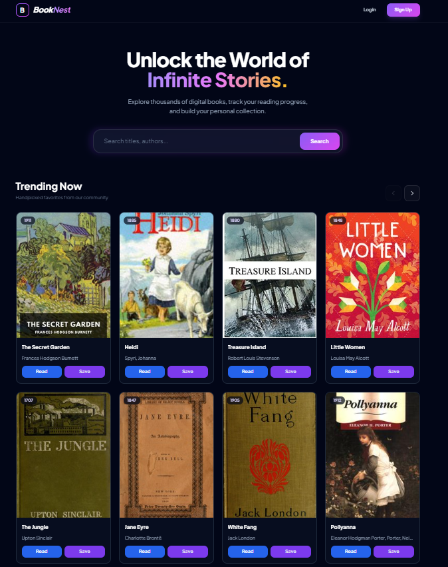
Key Platform Benefits
Universal Access: Read classic literature anytime, anywhere, on any mobile or desktop device.
Perfect Organization: Save your favorites with one click and never lose track of your reading progress.
Modern Design: A high-performance UI built with Tailwind CSS for ultimate readability.

Slide 4
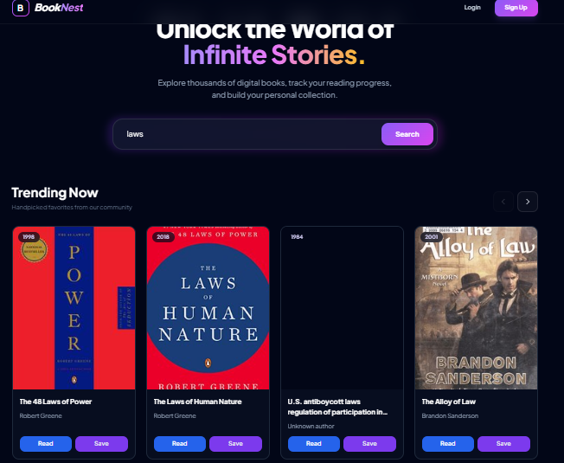
Real-Time Assistance
BookNest eliminates wait times. Search results are fetched and rendered in milliseconds, allowing for seamless discovery.
Through Cloud Firestore snapshots, your library is a living document. Add a book on your phone, and it appears on your tablet instantly.

Slide 5
The Creation Journey
Architecture
UI Design
Integration
Deployment
Designing Firestore schemas and auth with Firebase's built-in Authentication system
Developing a custom Tailwind CSS theme with mesh gradients and mobile-first responsiveness.
Connecting Gutendex and Open Library APIs using asynchronous ES modules and logic.
Optimizing build assets and launching on Vercel.

Slide 6
Thank You
BookNest: Infinite stories, one seamless nest.

